Slide 1
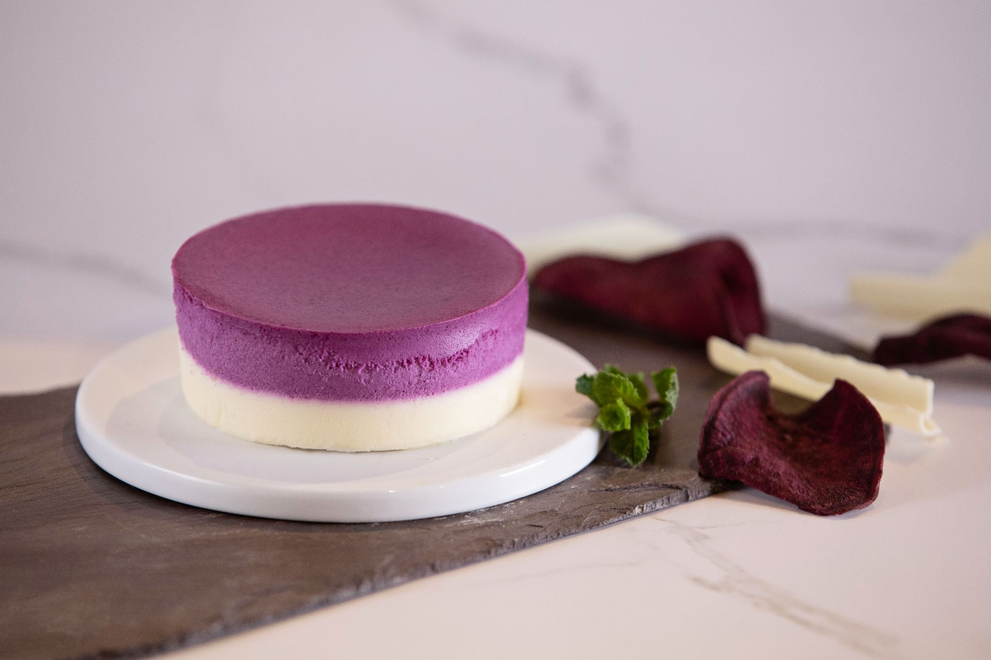
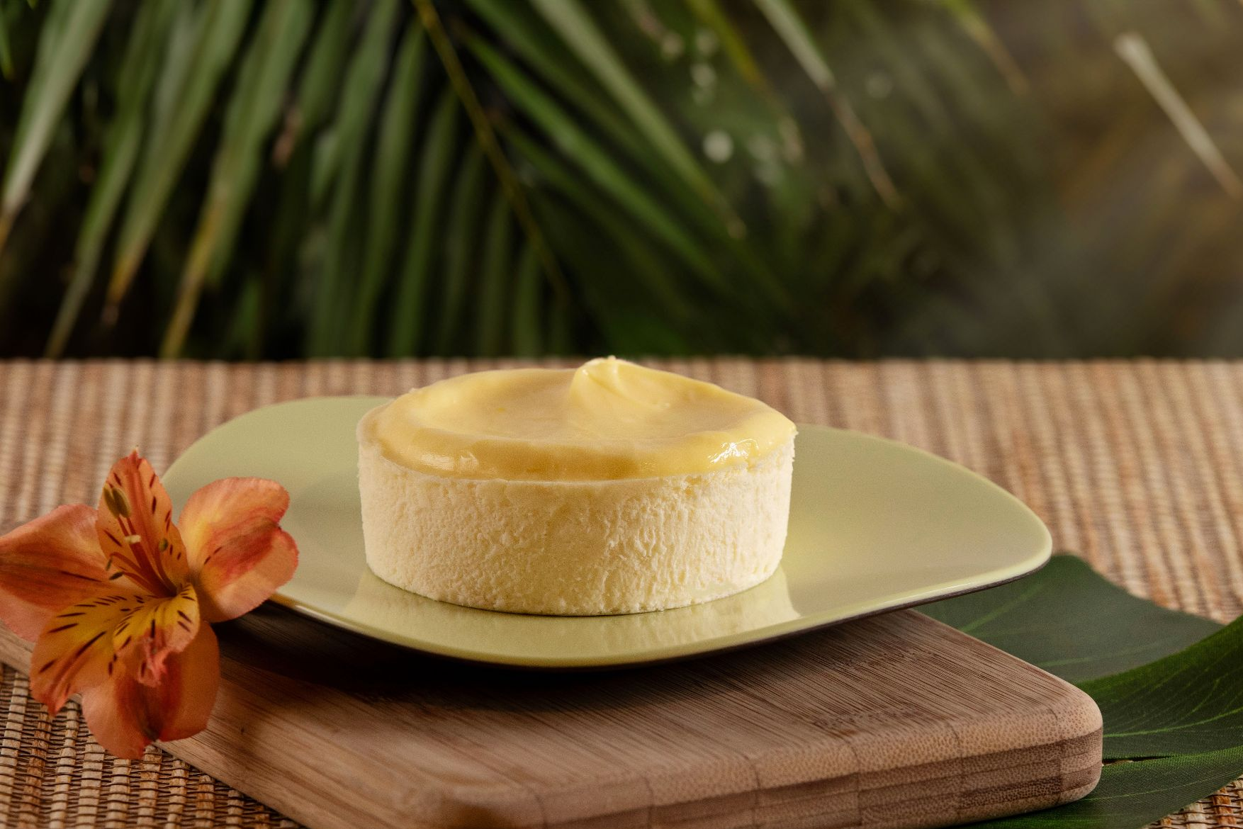
Sysco CES Spring 2024 Launch
Individual Manifesto® Cheesecakes
These products are gluten-free based on ingredient composition for use with a gluten-free lifestyle choice. They are produced in a facility that uses wheat in other products, therefore are not suitable for a medically necessary gluten-free diet.

Slide 2
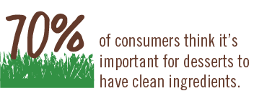
CLEAN INGREDIENTS IN DESSERT PRODUCTS
Datassential Sweet Street, Consumer Omnibus May 2023
S1: How important is it to you for a dessert product to have clean ingredients (i.e., ingredients are non-GMO, additive free, sustainable, made with rBST-free dairy products, etc.)? (n=1500)
S2: Please select which of the following, if any, are important to you when it comes to clean dessert products. (n=1500)
Notes:
S2 FULL LABELS IN GRAPH:
Free of additives
Non-GMO
No refined sugar (pure cane sugar)
Hormone-free dairy
Cage-free eggs
Sustainable
Gut Improving Ingredients – Apple Cider Vinegar, Ceylon Cinnamon, Collagen/Gelatin, Blueberry, Elderberry, Ginger, Piperine, Spirulina, Curcumin, Coconut Powder, Kiwi, Passion Fruit, Allulose Sustainable chocolate
Immunity Improving Ingredients – Mushrooms (e.g., Reishi, Turkey Tail, Chaga, Lions Mane, Cordyceps), Ginger, Turmeric, Ceylon Cinnamon, Ghee, Coconut Milk
Energy Improving Ingredients – Mushrooms (e.g., Reishi, Turkey Tail, Chaga, Lions Mane, Cordyceps), Ghee, Moringa Leaf
Other
None of the above

Slide 3
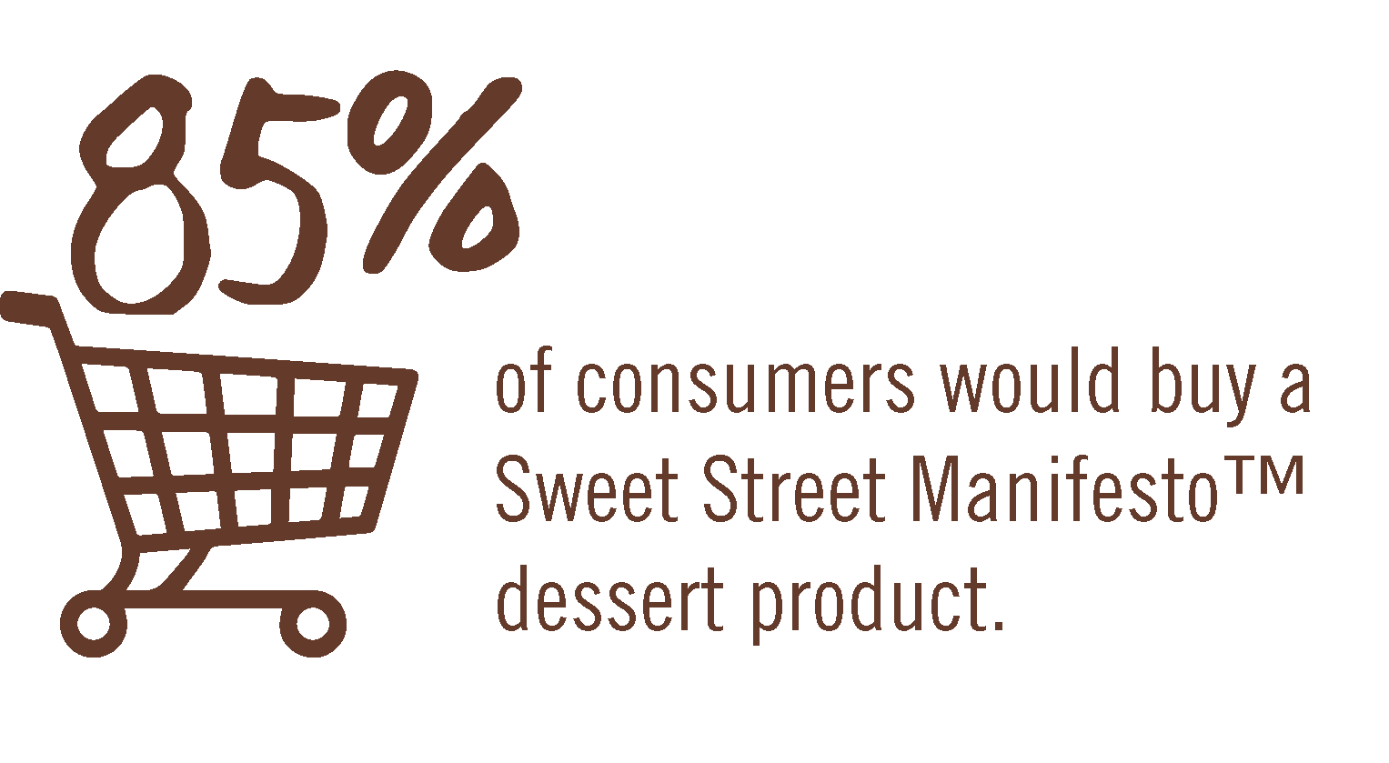
Datassential Sweet Street, Consumer Omnibus May 2023

Slide 4
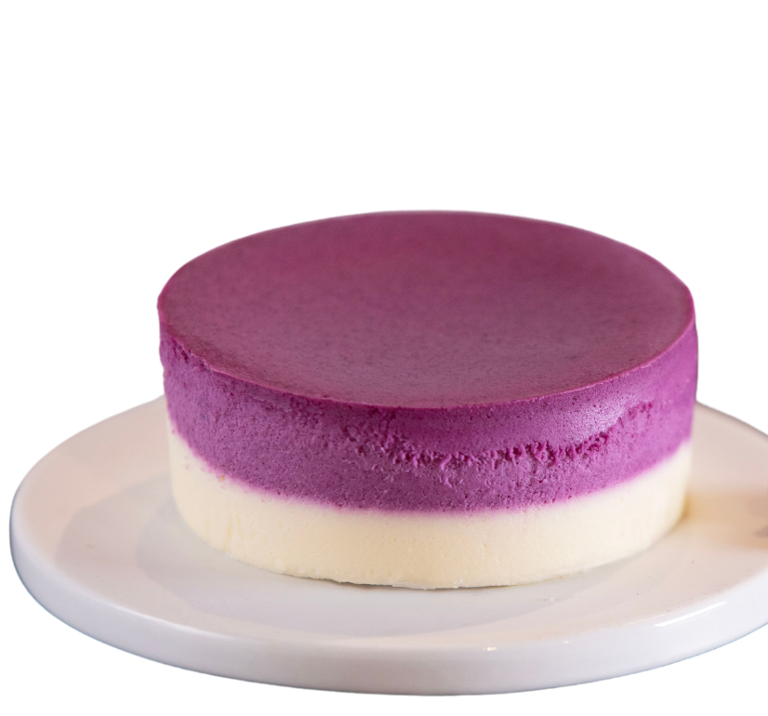
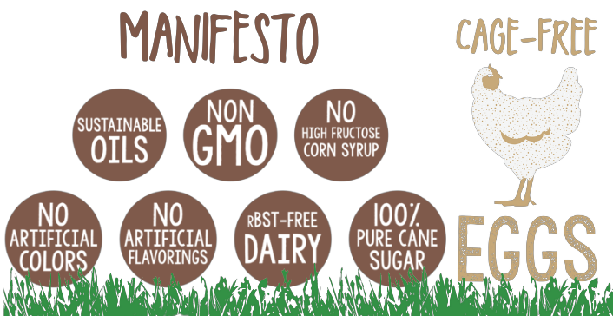
Individual Ube Manifesto® Cheesecake
This 3” individual cheesecake is best served chilled. The top layer, a naturally vivid violet layer of naturally rich, nutty vanilla-like Ube Cheesecake. Velvety in texture and unfolding complex flavor discovery, this cheesecake made with real purple sweet potato and complemented by a crustless bottom layer of vanilla cheesecake. Free of GMO’s and all things artificial and made with rBst-free dairy and cage-free eggs. Gluten-free.
SUPC | MPC | Description | Pack/Size
7282952 | 3653 | Individual Ube Manifesto® Cheesecake | 32/4.03oz
Approx Operator Cost
$3.00-$3.25 per portion

Slide 5
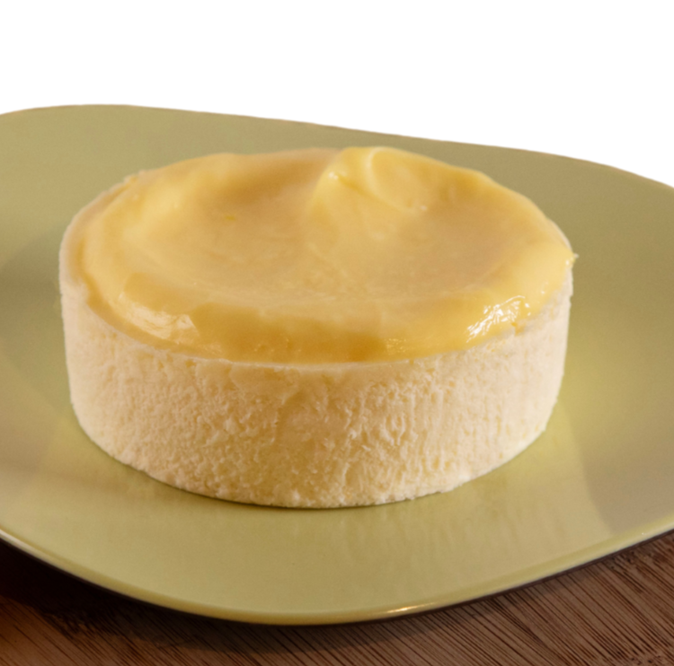
Individual Yuzu Manifesto® Cheesecake
This 3” individual cheesecake is best served chilled. Our smooth, creamy crustless cheesecake is mixed with tart citrusy Yuzu juice. Artistically, hand-topped with the natural sweetness of Yuzu curd. Free of GMO’s and all things artificial and made with rBst-free dairy and cage-free eggs. Gluten-free.
SUPC | Brand | Description | Pack/Size
7282936 | 3654 | Individual Yuzu Manifesto® Cheesecake | 32/4.03oz
Approx Operator Cost
$3.00-$3.25 per portion

Slide 6
DESSERT FLAVORS – JANUARY 2024
ginger
cookie dough
maple
apple
caramel
cinnamon
peppermint
butterscotch
coffee
graham cracker
orange
cranberry
key lime
lemon
pecan
strawberry
dipping sauce
nutella
mexican chocolate
smore
mocha
pretzel
vanilla
raspberry
honey
sage
five spice
persimmon
black forest
sour/tart cherry
toffee
red velvet
peanut butter
fudge
banana
saffron
king cake
pandan
citrus
cookie butter
olive oil
mango
dulce de leche
coconut
chocolate
almond
mangonada
spicy
smoked
sugar cookie
passion fruit
chocolate hazelnut
truffle
cream cheese
walnut
mint
earl grey
tahini
red bean
blood orange
brown butter
brown sugar
birthday cake
cherry
oreo
pumpkin
dates
tajin
turmeric
sesame
greek yogurt
snickerdoodle
sea salt
peach
blueberry
stout
matcha
black pepper
mascarpone
praline
espresso
chocolate ganache
dark chocolate
salted caramel
cajeta
rosemary
hibiscus
malt
watermelon
jam
cold brew
white chocolate
vanilla bean
basil
guava
meyer lemon
ube
ricotta
rhubarb
chocolate chip
marshmallow
rose
speculoos
avocado
apricot
sweet potato
whipped cream
thyme
balsamic
cardamom
bourbon/ whiskey
miso
yuzu
pistachio
marmalade
bacon
fig
lavender
inception fine dining, mixology, earliest stage
adoption
trendy restaurants + specialty grocers
proliferation
chain restaurants + mainstream grocery
ubiquity
find it just about anywhere

Slide 7
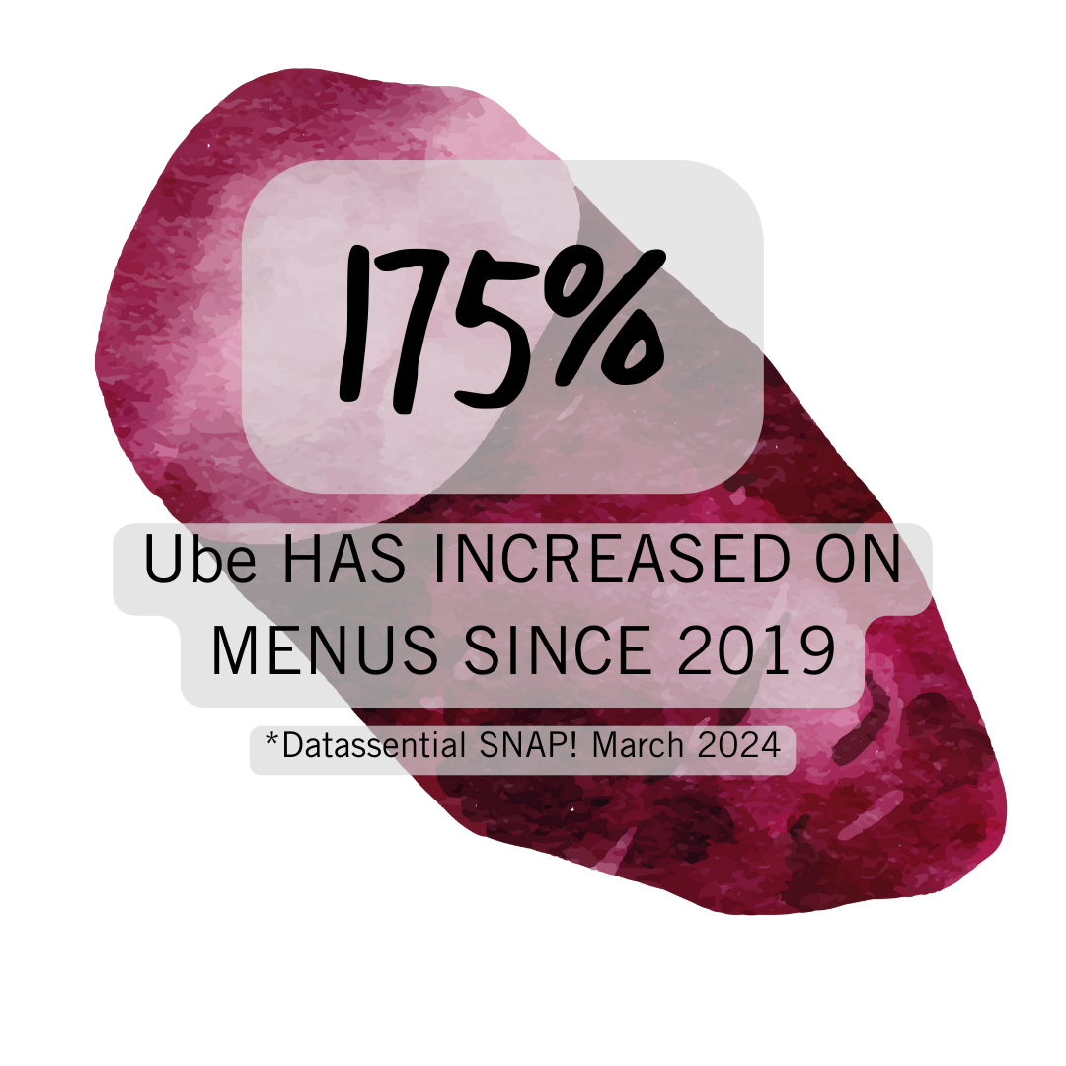
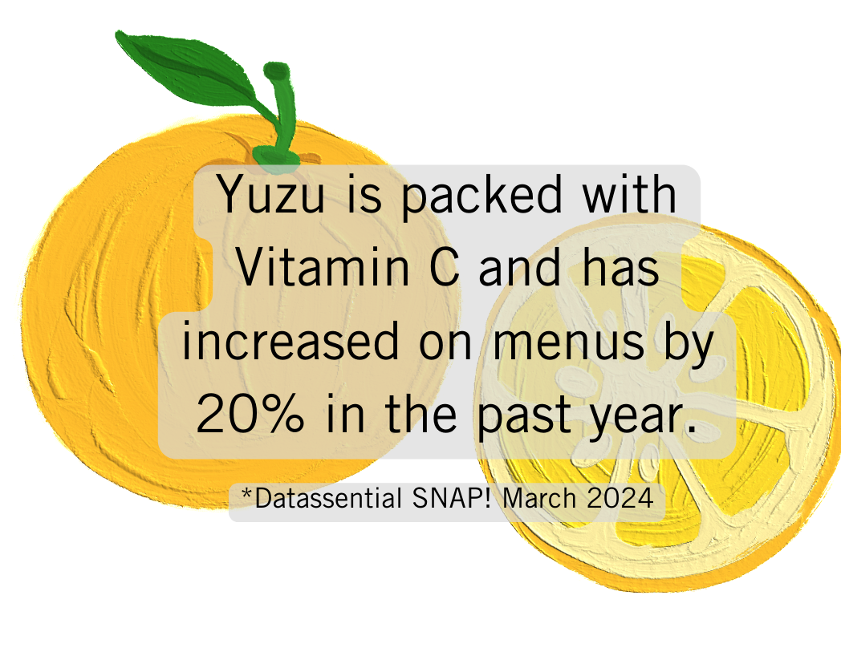
On-Trend Customer Benefits Pillars of CES!
Innovative and unique emerging flavors. Patrons willing to pay more - addresses “Profit Potential” criteria.
Thaw and serve convenience for an always fresh offering, no finishing required. May be easily prepared by front-of-house staff. Addresses “Labor Saving” criteria.
Worldly inspirations, personalized. Fills the gap and answers consumer demand, with on-trend flavors in an individual format. Addresses “on trend” criteria.
Individual format and elegant finish. Individual portion, for on-the-go or plated dessert – great artisan offering plated as-is or the perfect canvas your own individual plated concept - worthy of a pastry chef creation for the finest steak house but fits extremely well in Casual Dining Bar & Grill, Upscale Casual Dining, Lodging, Senior Living/Healthcare and more. Addresses “Versatility” criteria.
Boasts “free-from” and purposeful descriptors. Key terms for marketing and consumer point-of-purchase: rBst free dairy, cage free eggs, NON-GMO, sustainably grown oils and chocolates, free from artificial additives and flavors. Addresses “better for you” and “better for us” criteria.Gluten-free.
On trend benefits
On trend benefits

Slide 8
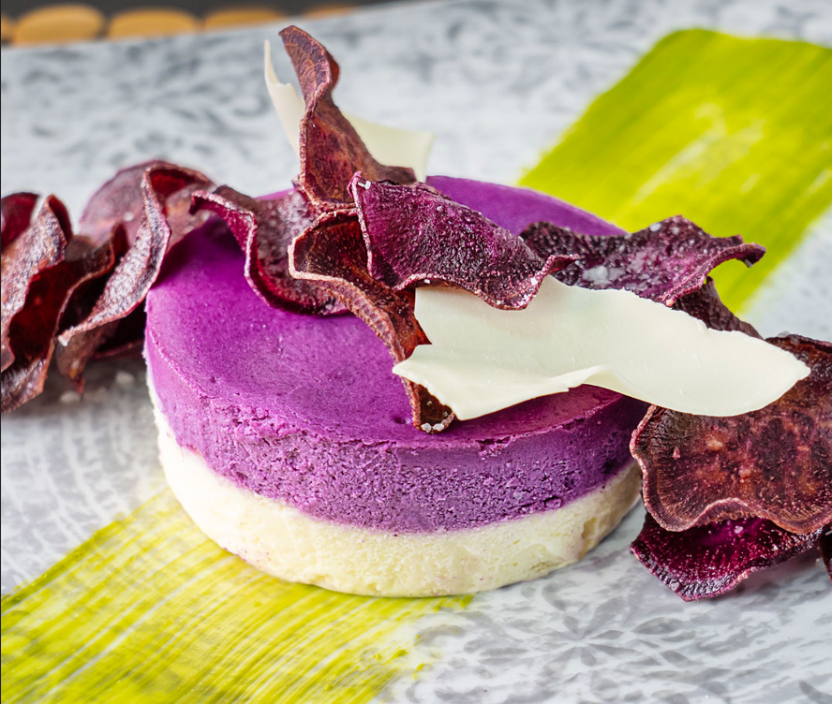
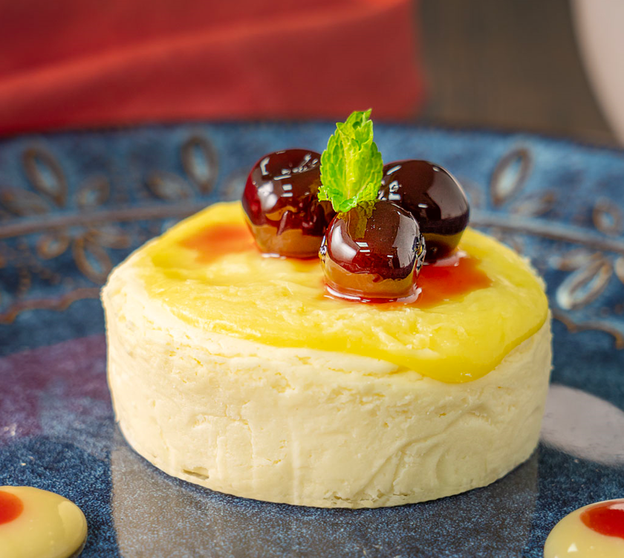
Menu Applications
Versatile - perfect as an Individual or shareable gourmet dessert, as-is or garnished/decorated by FOH/BOH staff (only 2 steps)
Delivery/Takeout/To-Go (travel well) individually or as a variety offering for family “meal deals”
Catered events (lunch, brunch and dinner) - dessert stations, buffets and plated events
Pairings: Riesling, Sauvignon Blanc, Iced Tea, Saki, English Style Pale Ale (ESB), Belgium Ale and Sour IPAs

Slide 9
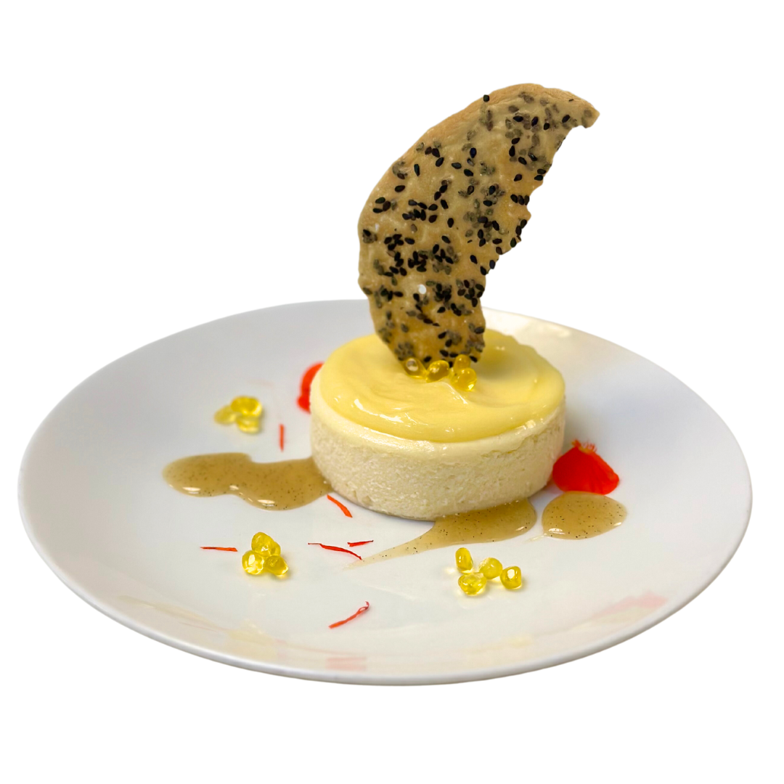
Target Customer Segments
Commercial: Upscale and Casual Dining/Bar & Grill, cafes, Italian, Mexican, Fast-Casual, QSR Coffee & Tea and Fine Dining
Non-Commercial: Healthcare including Senior Living, Catering, Casinos, Lodging, Colleges & Universities, Corporate Dining (B&I), Country Clubs, Sports Venues/Recreation and Ghost Kitchens
Handling Instructions
Thaw and Serve. Remove cheesecake from tray while still frozen, remove cardboard disc from bottom of cheesecake.
Thaw under refrigeration overnight (preferred method) or at room temperature for 3 hours.
Best served chilled.
Product holds 10 days covered in refrigeration.
18 month frozen

Slide 10
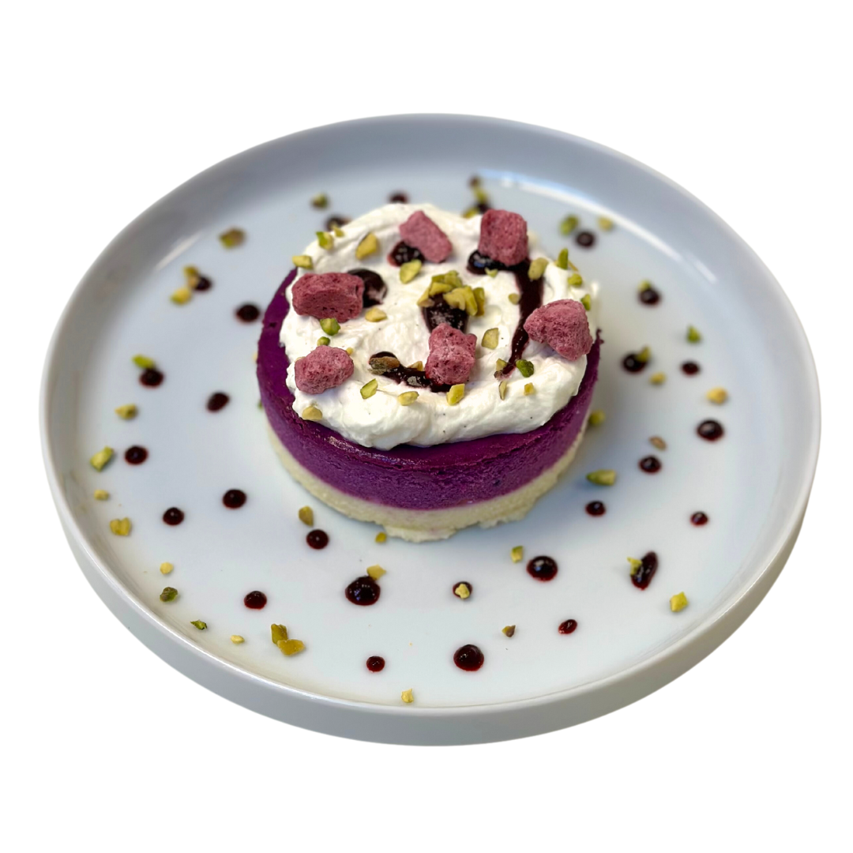
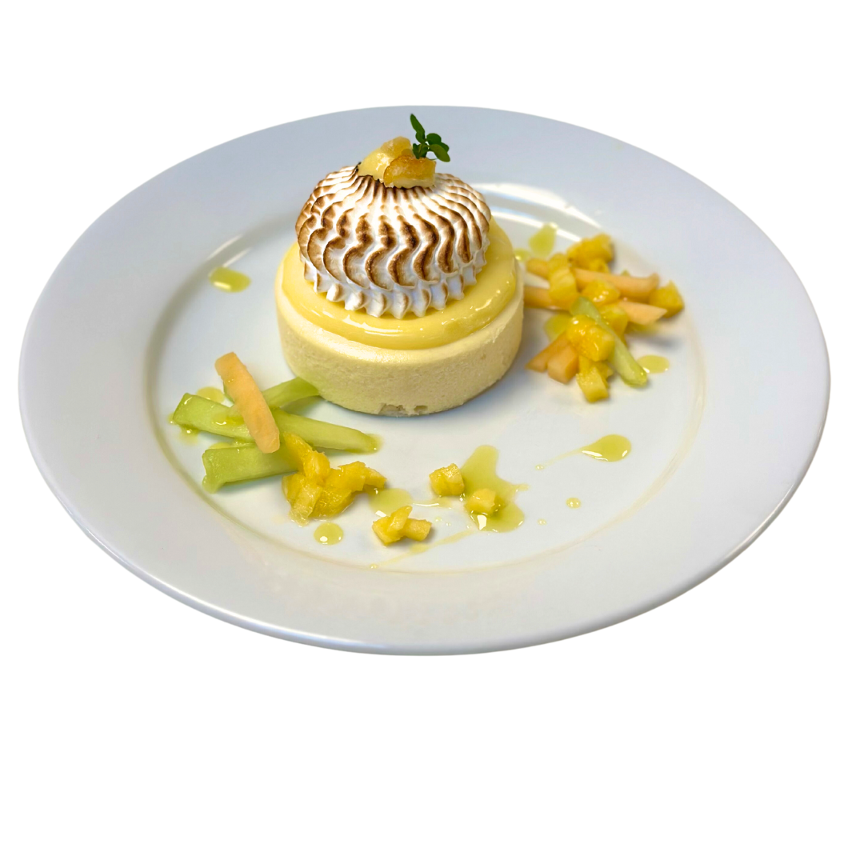
Additional Info
Official Launch DATE is April 19, 2024
Both items exclusive to Sysco for 1 year effective March 2024
Products are available for the Sysco Operating Sites to order via
Chicago Preferred (Lineage Chicago III)
Sysco SE RDC
Dot Foods
Note: Sweet Street does NOT deliver any orders to Sysco Operating Sites
These products will be a part of the local marketing programs.
Standard Broker Commission
Funds have been paid to corporate to defray the cost of marketing efforts. There will be special events and areas set aside to support the CES initiative.
Sysco CES-approved marketing and POS materials will be communicated
We are in the process of getting both items approved by key Program Accounts that are aligned with Sysco

Slide 11
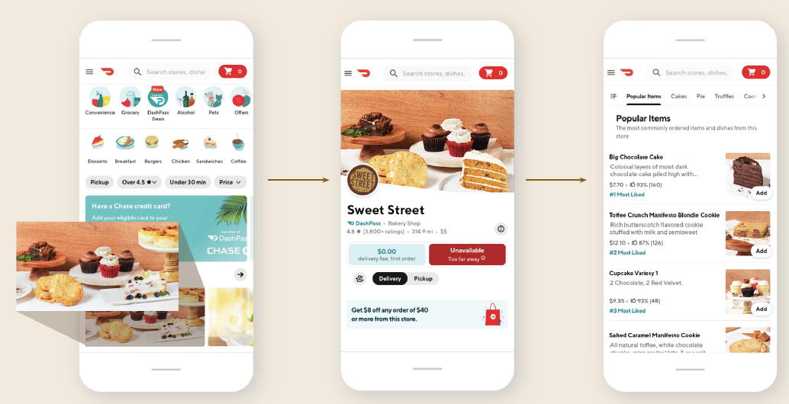
DoorDash Promotion
DoorDash merchants (Sweet Street Storefronts) purchase via Sysco.
Sysco has approved early orders at select Sysco sites
100+ DoorDash/Sweet Street storefronts will be selling Ube and Yuzu as a Mothers Day LTO

Slide 12
CONTACT INFORMATION
Supplier Information
Sweet Street Desserts
Chris Davis
chris.davis@sweetstreet.com
541-647-8067
Broker Information
Chad Gaines
VP-Sysco Business Team
CORE Foodservice
206-276-1720
cgaines@corefoodservice.com

