Slide 1
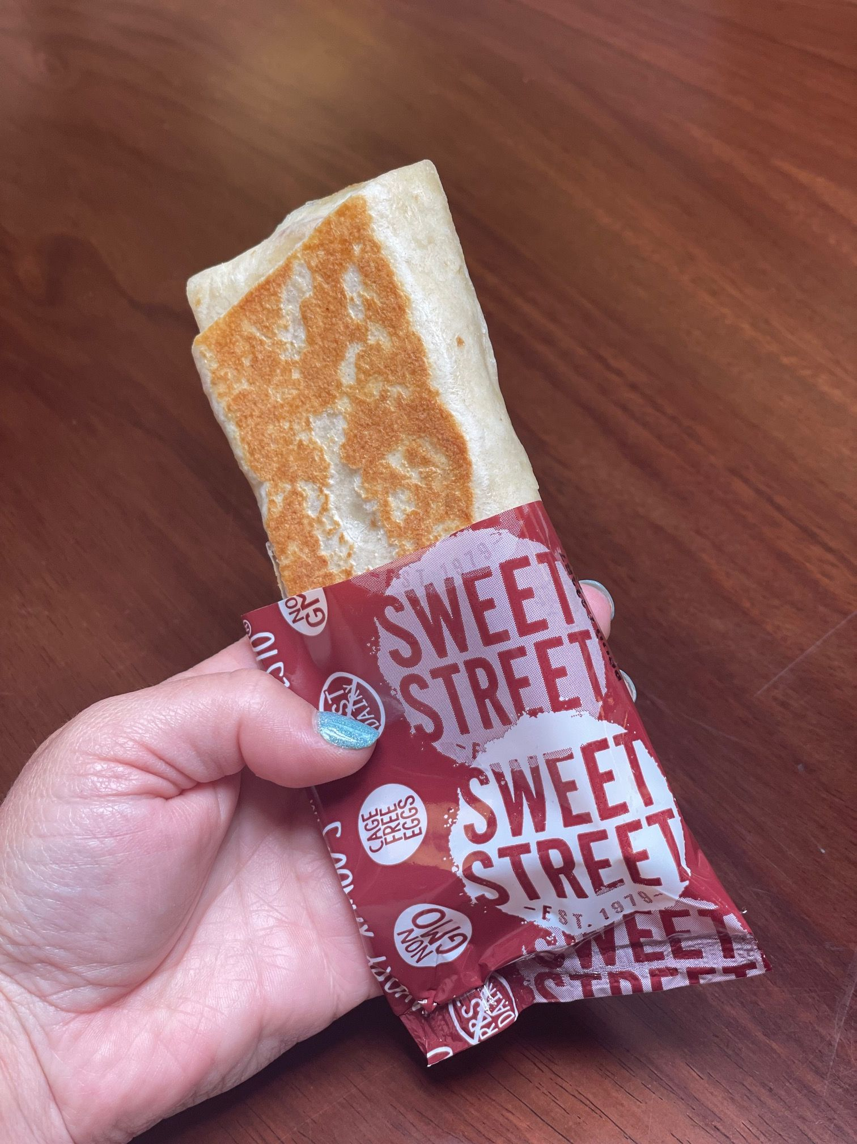
Manifesto® Savory XANGOS™
HEATING INSTRUCTIONS

Slide 2
Deep Fryer, Air Fryer, Panini Press & Ovens
INSTRUCTIONS - ALL FLAVORS
Deep Fry
(From Refrigerated only)
Preheat Oil to 350°F
Deep Fry for 7-8 minutes
Panini Press
(From Refrigerated only)
3 minutes @ 400°F
Air Fryer
(From FROZEN)
14 minutes @ 390°F
(From Thawed/REFRIGERATION)
10 minutes @ 390°F
CONVECTION OVEN
Preheat Oven to 450°F
Line tray with Parchment paper
FROM FROZEN Bake 12 minutes
FROM Thawed/REFRIGERATION Bake 8 minutes
CONVENTIONAL OVEN/Toaster Oven
Preheat Oven to 450°F
Line tray with Parchment paper
FROM FROZEN Bake 20 minutes
FROM Thawed/REFRIGERATION Bake 15 minutes

Slide 3
Turbo Chef Settings
INSTRUCTIONS All Flavors
Remove wrapper prior to baking. Guidelines for heating 1 XANGO at a time.
Thawing Instructions: Remove the desired amount of portions from the freezer and place on a sheet pan in the cooler, keep in film to prevent drying & defrost overnight. Can be kept refrigerated for up to 7 days prior to heating. Remove film wrapper prior to baking.
500°F/High Fan | Events | % of Time | % Top | % Bottom | % Wave | Time
from FROZEN | 1 | 100 | 60 | 30 | 20 | 2:45
from thawed/Refrigeration | 1 | 100 | 70 | 30 | 20 | 2:10

Slide 4
Merrychef
INSTRUCTIONS All Flavors
1X PORTION FROZEN
Time: 2 minutes & 15-30 seconds
Fan: 10%
Micro: STEP 1: 40% 1 minute 15-20 seconds
STEP 2: 25% 1 minute 15-25 seconds
2X PORTIONS FROZEN
Time: 3 minutes & 15-30 seconds
Fan: 10%
Micro: STEP 1: 40% 1 minute 40-45 seconds
STEP 2: 25% 1 minute 35-45 seconds
1X PORTION THAWED/REFRIGERATED
Time: 1 minute & 30 seconds
Fan: 60%
Micro: 30%
2X PORTIONS THAWED/REFRIGERATED
Time: 2 minutes & 15 seconds
Fan: 45 %
Micro: 35 %

