Slide 1
GLOBAL FLAVORS
SAVORY INDULGENCE
ICONIC FORMAT
ManifestoⓇ Savory XANGOS™ are here!

Slide 2
42%
of consumers are more likely to try a new or unique flavor from a restaurant than when cooking from home*
28%
of consumers are more open to experimentation than two years ago*
On average, consumers
order new or unique items
from restaurants
more than 25%
of the time**
*Base: Approx. 800 consumers
**Base: Approx. 500 consumers
Source: Technomic Flavor Consumer Trend Report

Slide 3
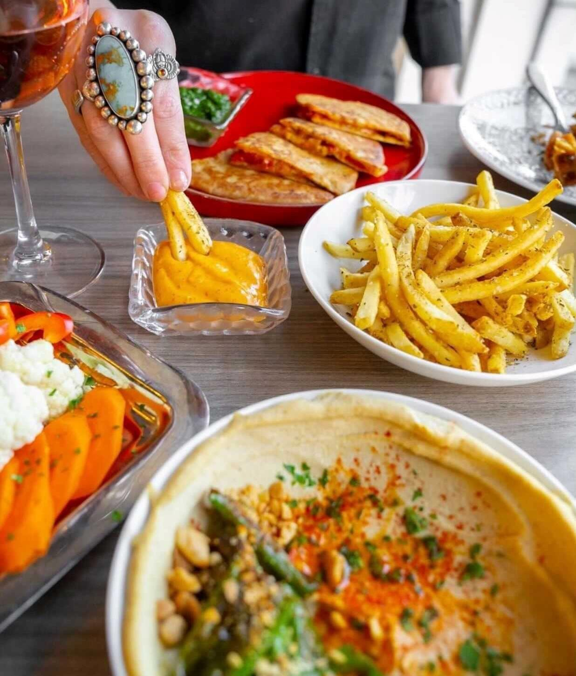
New Flavors With Classic Dishes
Za’atar Spiced Fries—with harissa aioli (Ash’Kara in Denver)
Dank Fries—Rare Tea Cellar furikake, smoked trout roe, soy sauce pearls and gochujang mayo on top of hand-cut fries (Pizza Fried Chicken Ice Cream in Chicago)
Furikake Fries—with Sriracha ketchup (Anthem in Austin, Texas)
36%
of consumers are more likely to try a new or unique flavor if it is showcased in a traditional or familiar way*
*Base: Approx. 800 consumers
*Source: Technomic 2021 Flavor Consumer Trend Report Image Source: Ash’Kara Facebook
12

Slide 4
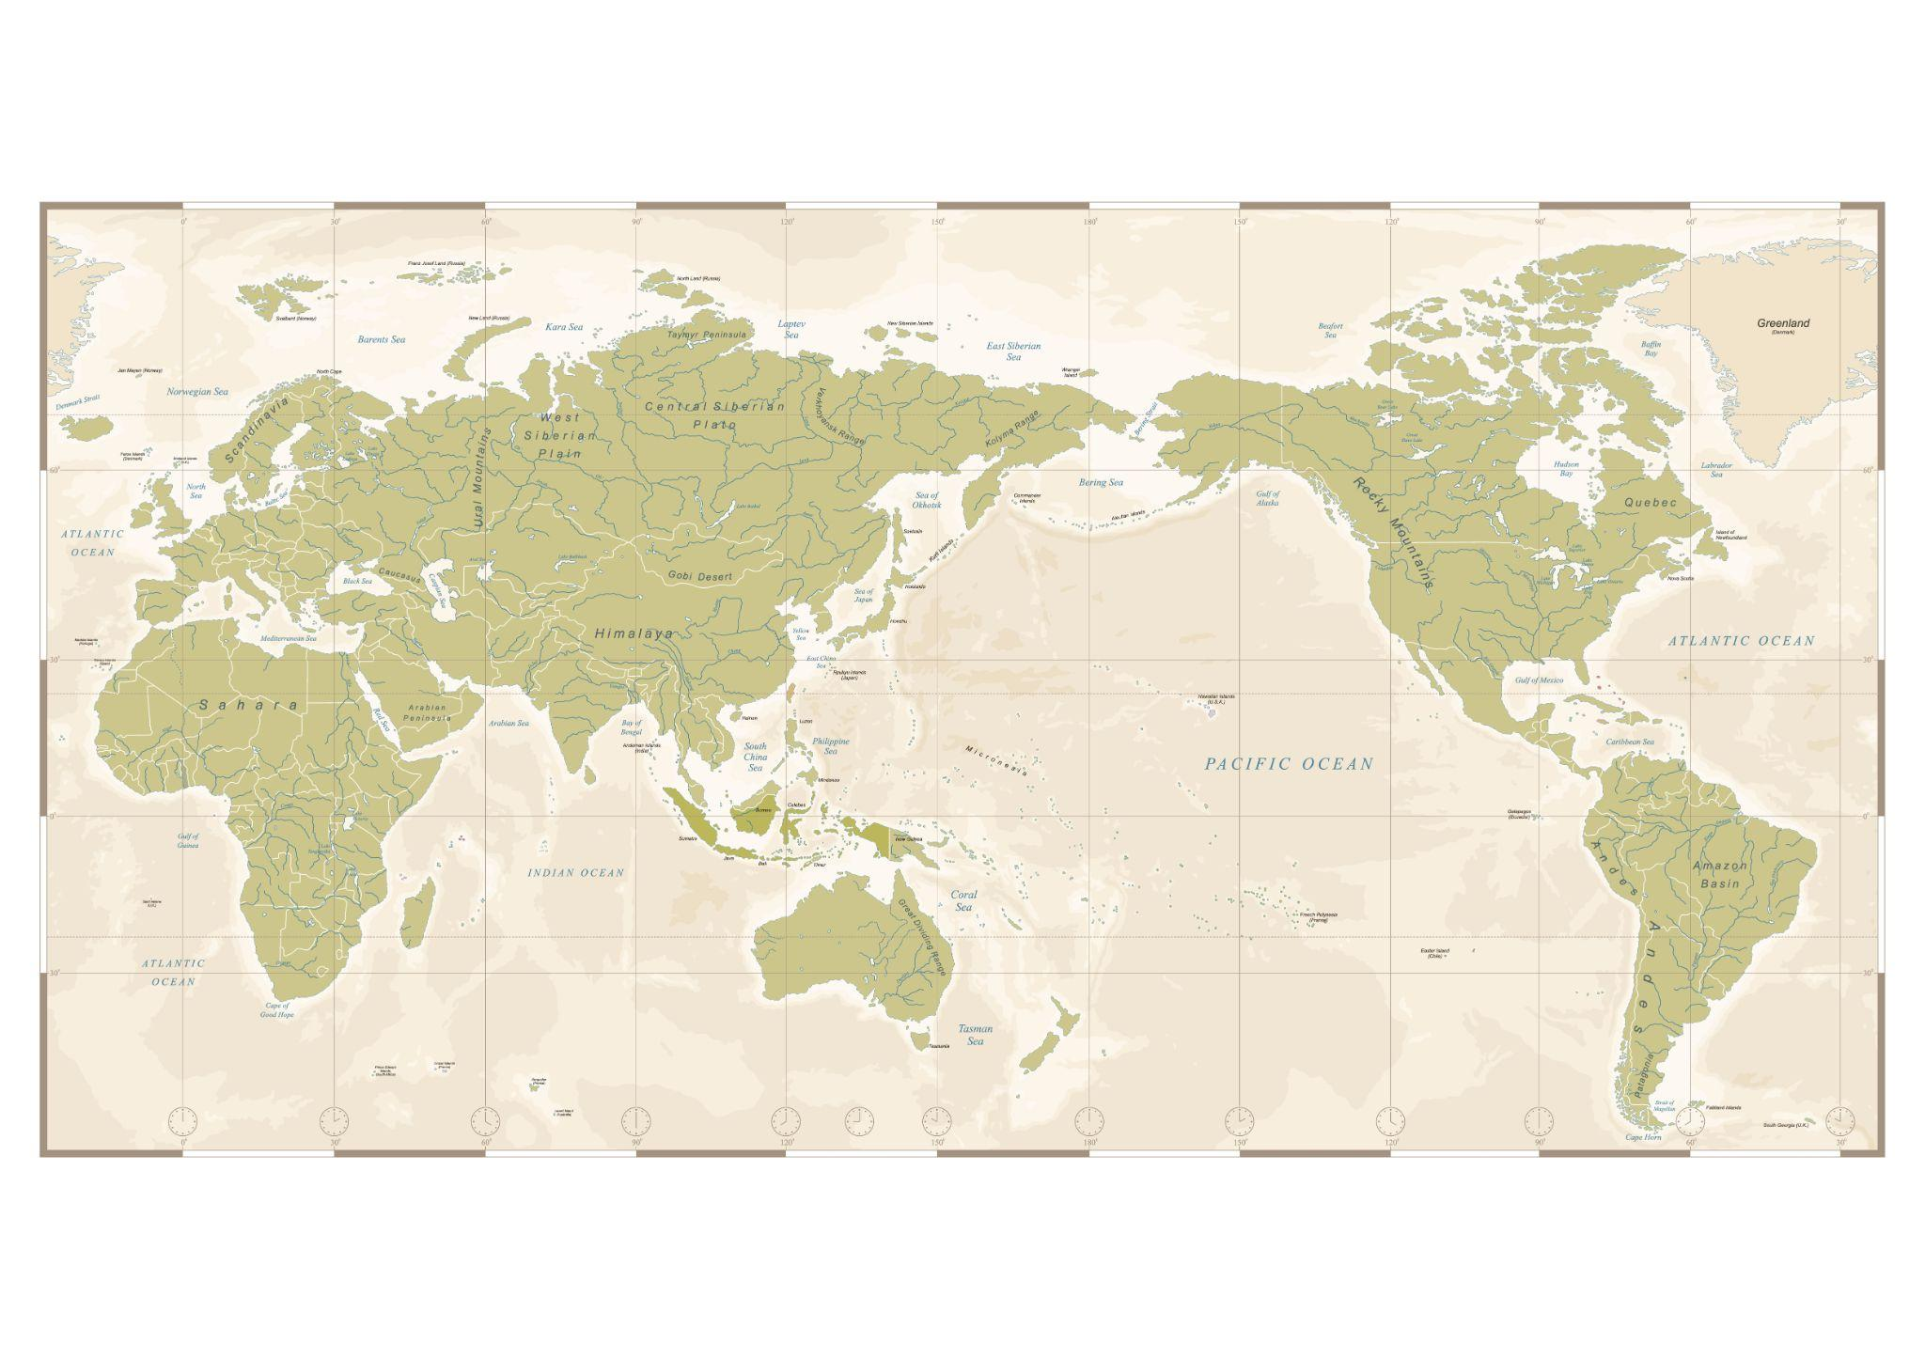
27%
of consumers are eating more unique type of global foods and beverages now that they did two years ago
Global Spotlight of the Year
Base: 869 consumers who ever order global foods Source: Technomic 2022 Global Food & Beverage Consumer Trend Report
Image Source: Shutterstock
Western
Asia
Mesoamerica
Western Africa

Slide 5
Global Cuisine Types
| Menu Adoption Cycle | Aug 2022
regional us
japanese
creole/cajun
regional mexican
southern
italian
australian
canadian
cuban
mizrahi
greek
chinese
mexican
sephardic
croatian
ashkenazi
regional italian
tex mex
iranian
central american
venezuelan
caribbean
mediterranean
thai
south african
sicilian
regional chinese
southwestern
malaysian
native american
israeli
middle eastern
ethiopian
lebanese
indian
scandinavian
moroccan
hawaiian
irish
persian
filipino
brazilian
vietnamese
french
peruvian
russian
german
turkish
spanish
korean
polish
argentinian
jamaican
oaxacan
inception fine dining, mixology, earliest stage
adoption
trendy restaurants + specialty grocers
proliferation
chain restaurants + mainstream grocery
ubiquity
find it just about anywhere

Slide 7
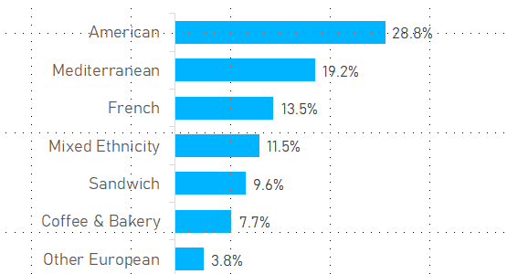
SHAKSHUKA
menu availability
FOUND ON MENU TYPES
APPLICATIONS
PAIRED FLAVORS
share of total incidence
share of total incidence
overlap with other items
Egg Dish | 76.9%
Combos/Multi Protein | 7.7%
Hot Sandwich | 3.8%
Other App | 1.9%
Beef Main Entree | 1.9%
Other Protein Main Entree | 1.9%
Veggie Main Entree | 1.9%
Pizza | 1.9%
Protein Side | 1.9%
Other | 0%
EGG | 97.6%
TOMATO | 56.1%
PEPPER | 41.5%
FETA | 39%
ONION | 39%
POACHED | 36.6%
BAKED | 26.8%
POACHED EGG | 24.4%
CILANTRO | 22%
SPICED | 22%
FREE | 19.5%
PITA | 17.1%
CUMIN | 14.6%
GLUTEN FREE | 14.6%
GRILLED | 14.6%
SHIRRED EGG | 14.6%
among menu items with SHAKSHUKA, % that also contain each of the above; use this to find flavors that go together
data filtered on: all US menu categories

Slide 8
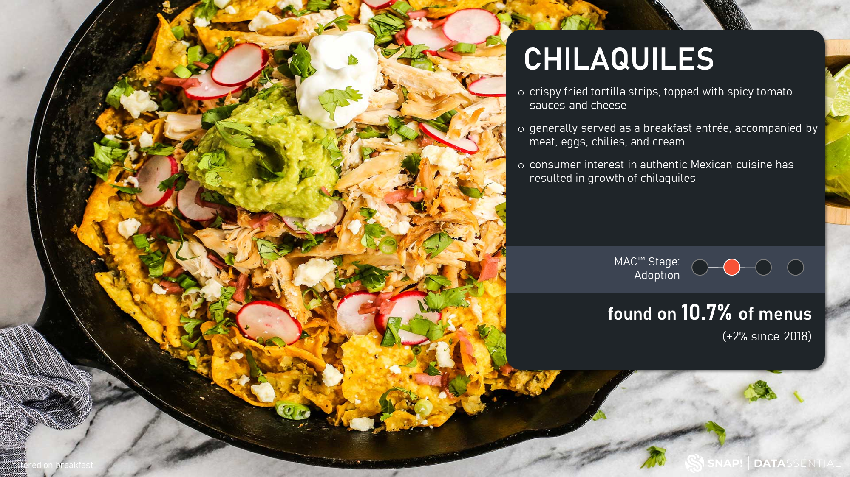

Slide 9
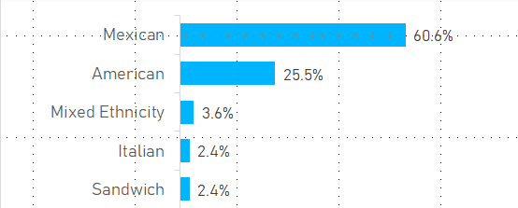
CHILAQUILES
menu availability
FOUND ON MENU TYPES
APPLICATIONS
PAIRED FLAVORS
share of total incidence
share of total incidence
overlap with other items
Mexican Entree | 84.8%
Combos/Multi Protein | 9.7%
Egg Dish | 4.8%
Veggie Main Entree | 0.6%
Other | 0%
EGG | 84.3%
SALSA | 46.4%
TORTILLA | 45%
CORN TORTILLA | 39.3%
BEAN | 36.4%
ONION | 36.4%
CHIPS | 35%
FRIED | 31.4%
QUESO | 27.1%
TORTILLA CHIPS | 26.4%
CILANTRO | 25.7%
CHICKEN | 23.6%
AVOCADO | 20.7%
queso fresco | 20.7%
SCRAMBLED | 20%
crema | 18.6%
among menu items with CHILAQUILES, % that also contain each of the above; use this to find flavors that go together

Slide 10
MEDITERRANEAN
cuisine characteristic of countries surrounding the Mediterranean sea
characterized by use of olive oil, olives, fresh vegetables, hummus, balsamic vinegar, wine, and wheat
popularized in the 1970s in the U.S. as a diet to follow for healthier eating habits
MAC™ Stage: Proliferation
found on 14.4% of menus
(-6% since 2018)
data filtered on: all US menu categories

Slide 11
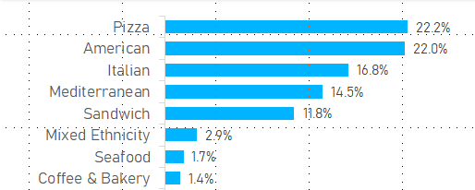
MEDITERRANEAN
menu availability
FOUND ON MENU TYPES
APPLICATIONS
PAIRED FLAVORS
share of total incidence
share of total incidence
overlap with other items
Pizza | 16.6%
Entrée Salad | 14.7%
Appetizer Salad | 9.6%
Cold Sandwich | 7.7%
Combos/Multi Protein | 7.7%
Fish Main Entree | 4.6%
Hot Sandwich | 4.4%
Rice Entree | 3.2%
Chicken Main Entree | 3%
Wine | 2.8%
Sampler | 2.6%
Pasta/Noodles | 2.3%
Egg Dish | 2.3%
Non-Fried Protein App | 1.4%
Appetizer Dip | 1.3%
Deli Salad Appetizer | 1.3%
Shellfish Main Entree | 1.3%
Other | 13%
TOMATO | 64.1%
FETA | 54.2%
olive | 46.5%
SALAD | 43.2%
ONION | 41.7%
CHICKEN | 32.4%
CUCUMBER | 31.2%
PEPPER | 30.7%
GREEK SALAD | 25%
SPINACH | 25%
GRILLED | 24.8%
ROASTED | 24.7%
KALAMATA OLIVE | 23.5%
VINAIGRETTE | 20%
GARLIC | 19.7%
PIZZA | 17%
a high MENU VERSATILITY SCORE indicates an item that works well in many different cuisines
food versatility score
41
a high FOOD VERSATILITY SCORE indicates an item that works well in many different applications.
among menu items with MEDITERRANEAN, % that also contain each of the above; use this to find flavors that go together
data filtered on: all US menu categories

Slide 12
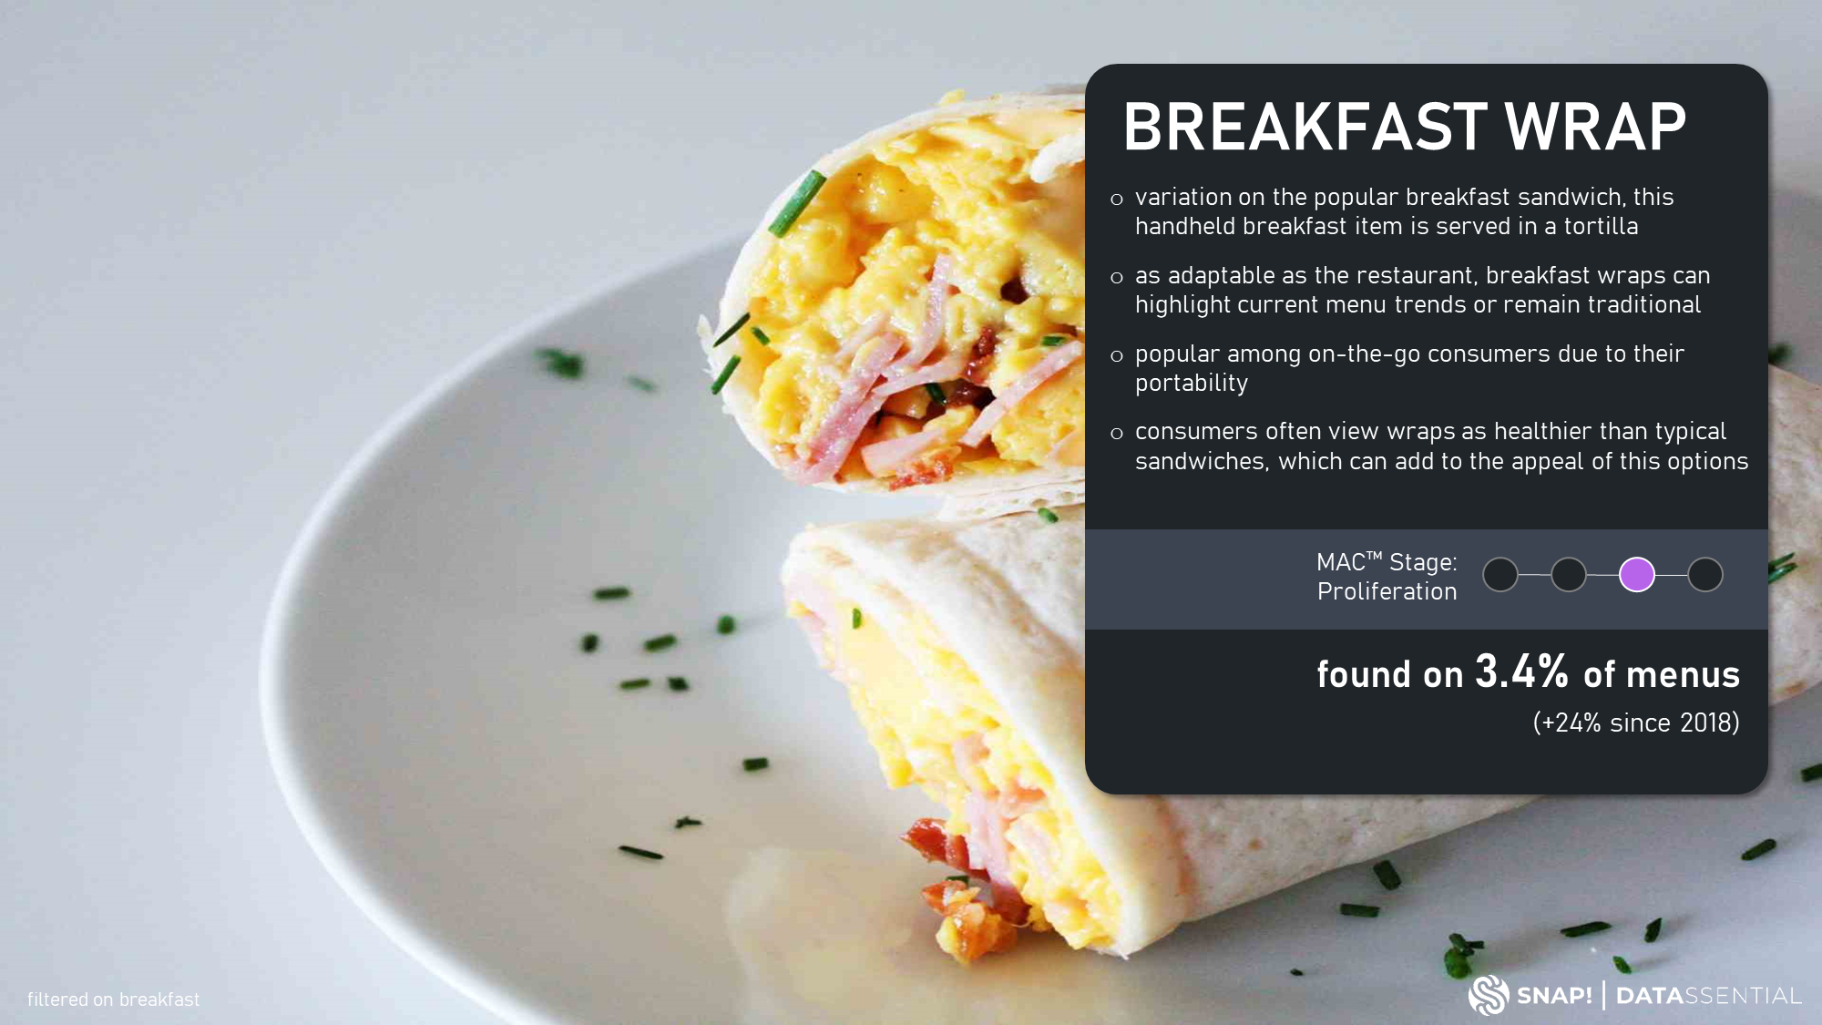

Slide 13
Today, customers are explorers hungry for exciting, global flavors while treasuring traditional and familiar fare. Our ManifestoⓇ Savory XANGOS™ have been layered with carefully selected bold ingredients and unexpected flavor profiles such as shakshuka and chilaquiles while honoring classics such roasted red peppers, crisp vegetables and creamy cage-free egg custard.
All Day Parts; Breakfast, Brunch, Lunch, Dinner, Late-Night Nosh
Operationally friendly
Freezer to Turbo Chef
On-Trend, Global Flavors
Better-for-You Ingredients
Craveable Experience

Slide 14
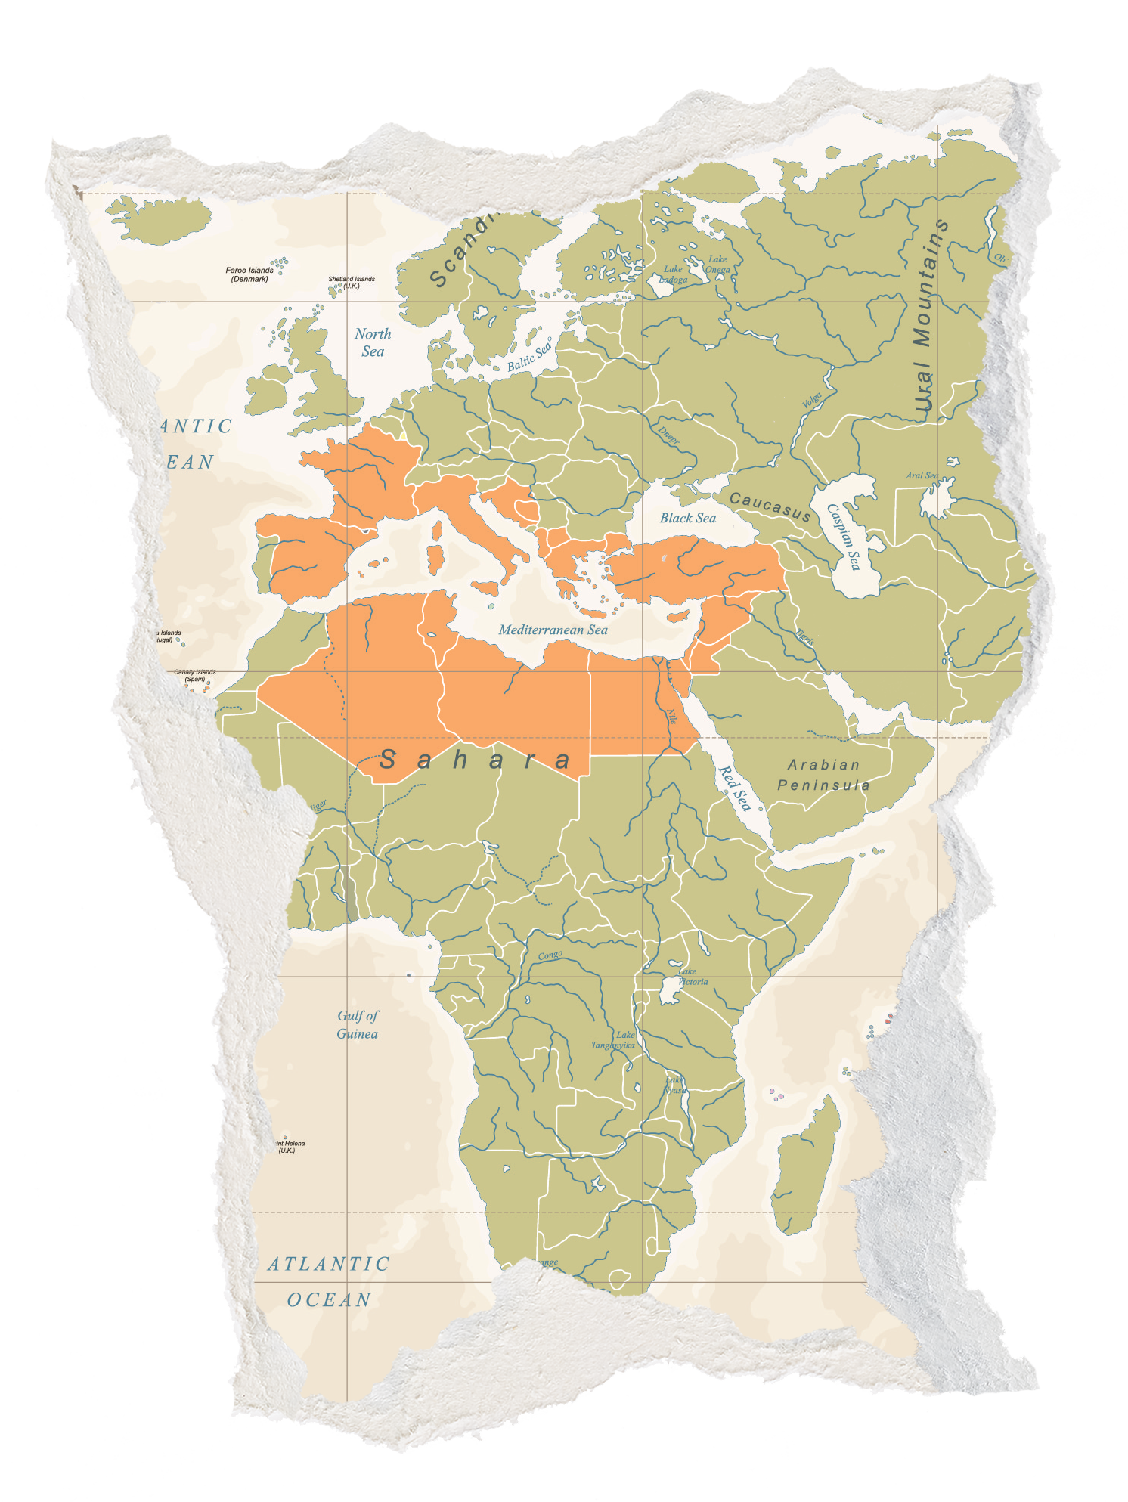
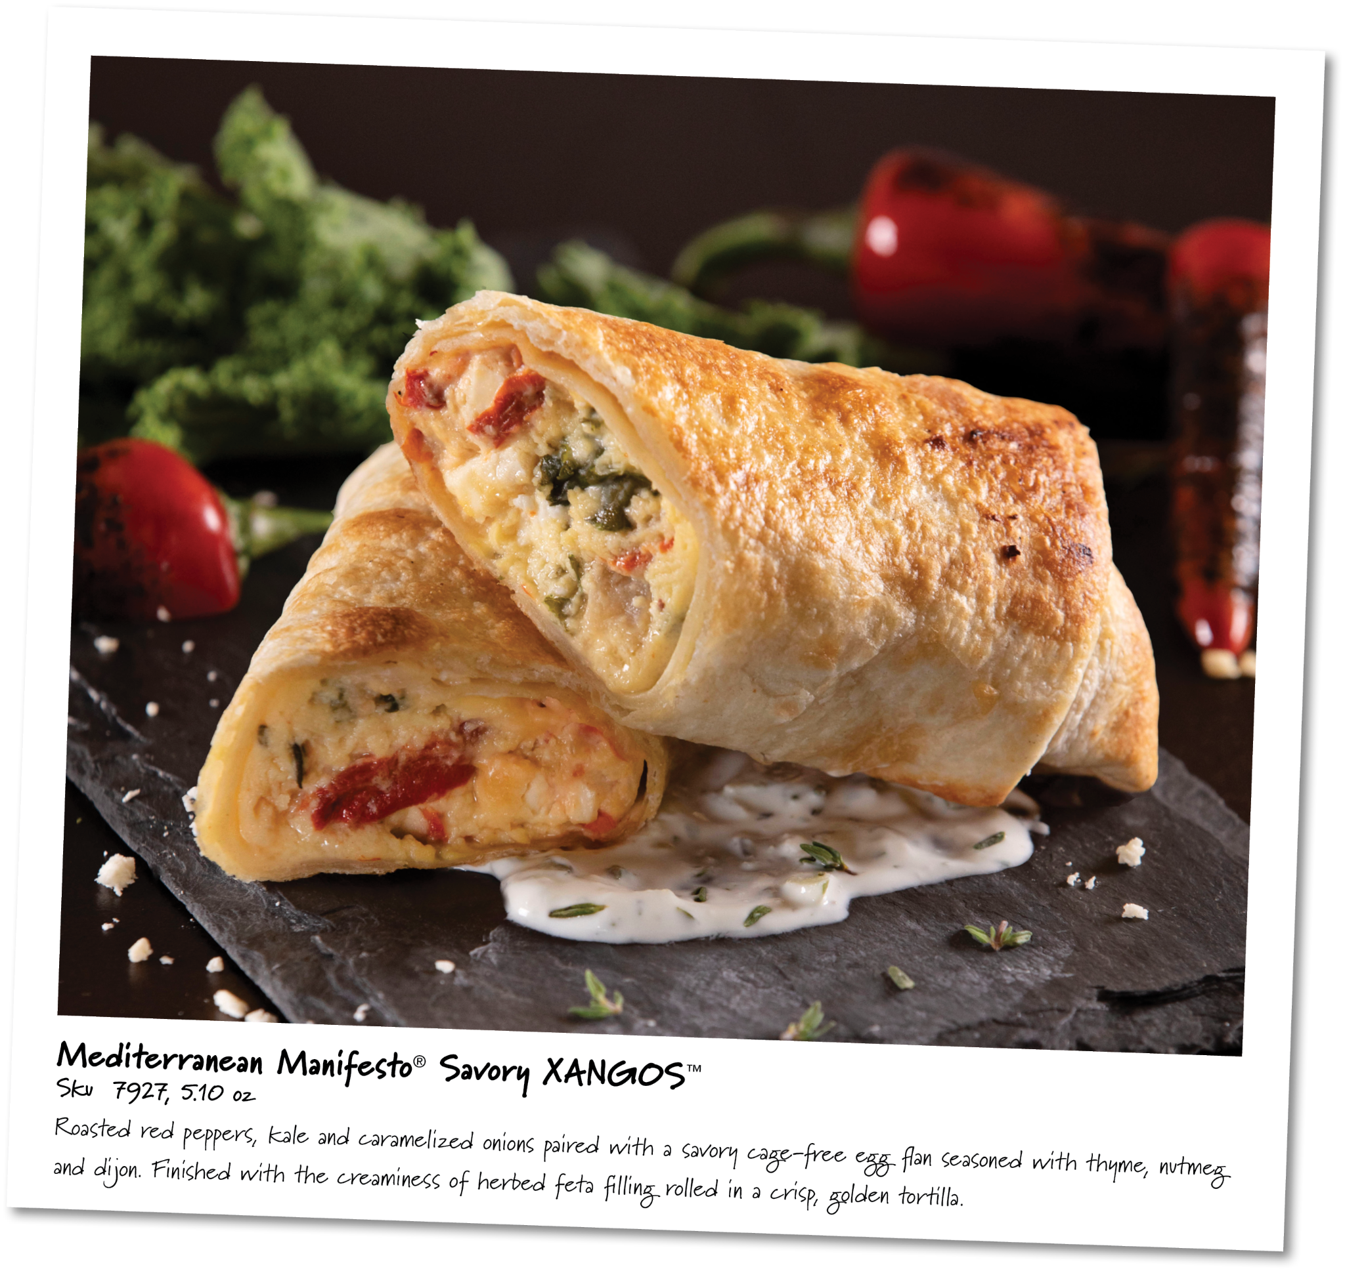
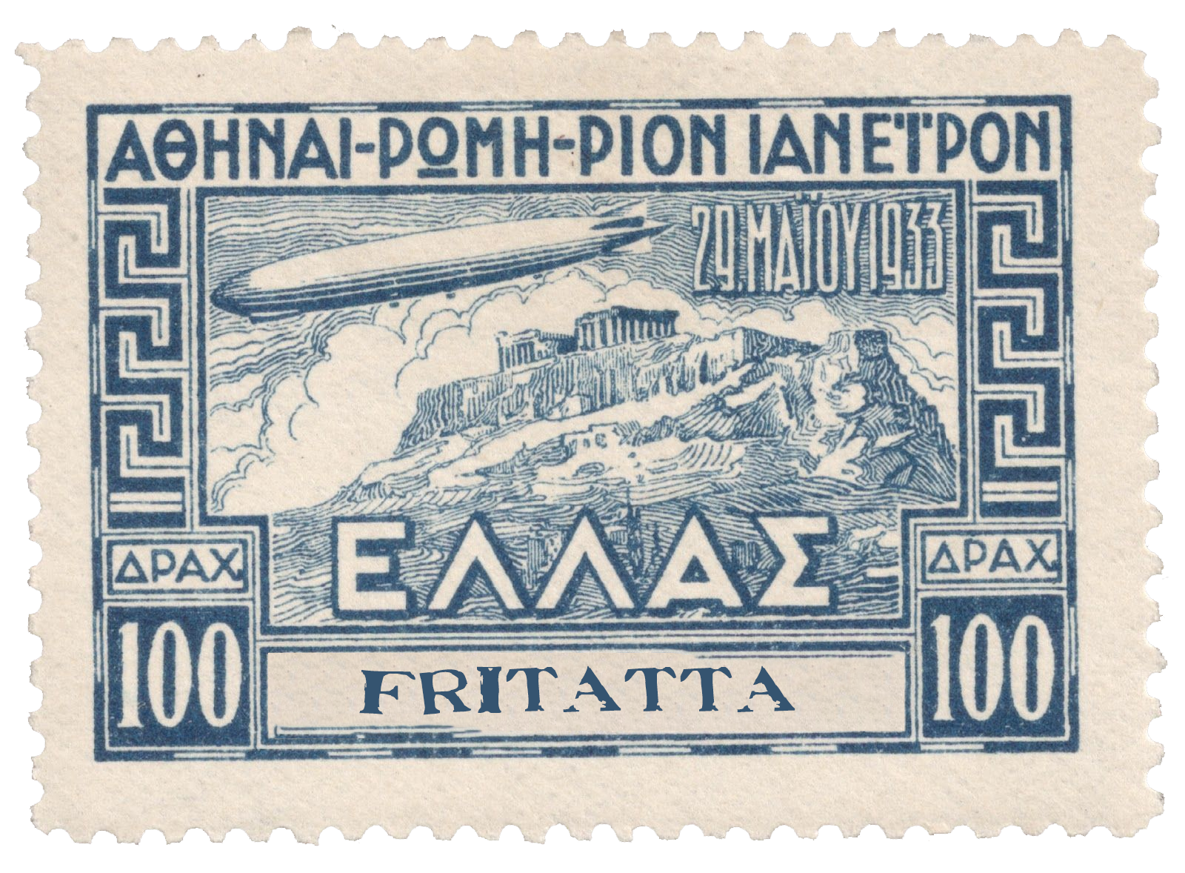
Inspiration: Mediterranean Frittata
Tradition:
A delicious combo of cultures and cooking methods - eggs are beaten to a fluff as garden-fresh vegetables and savory cheeses are folded in. Slowly baked in a woodfired oven, until ready to be served al fresco with the entire family.

Slide 15
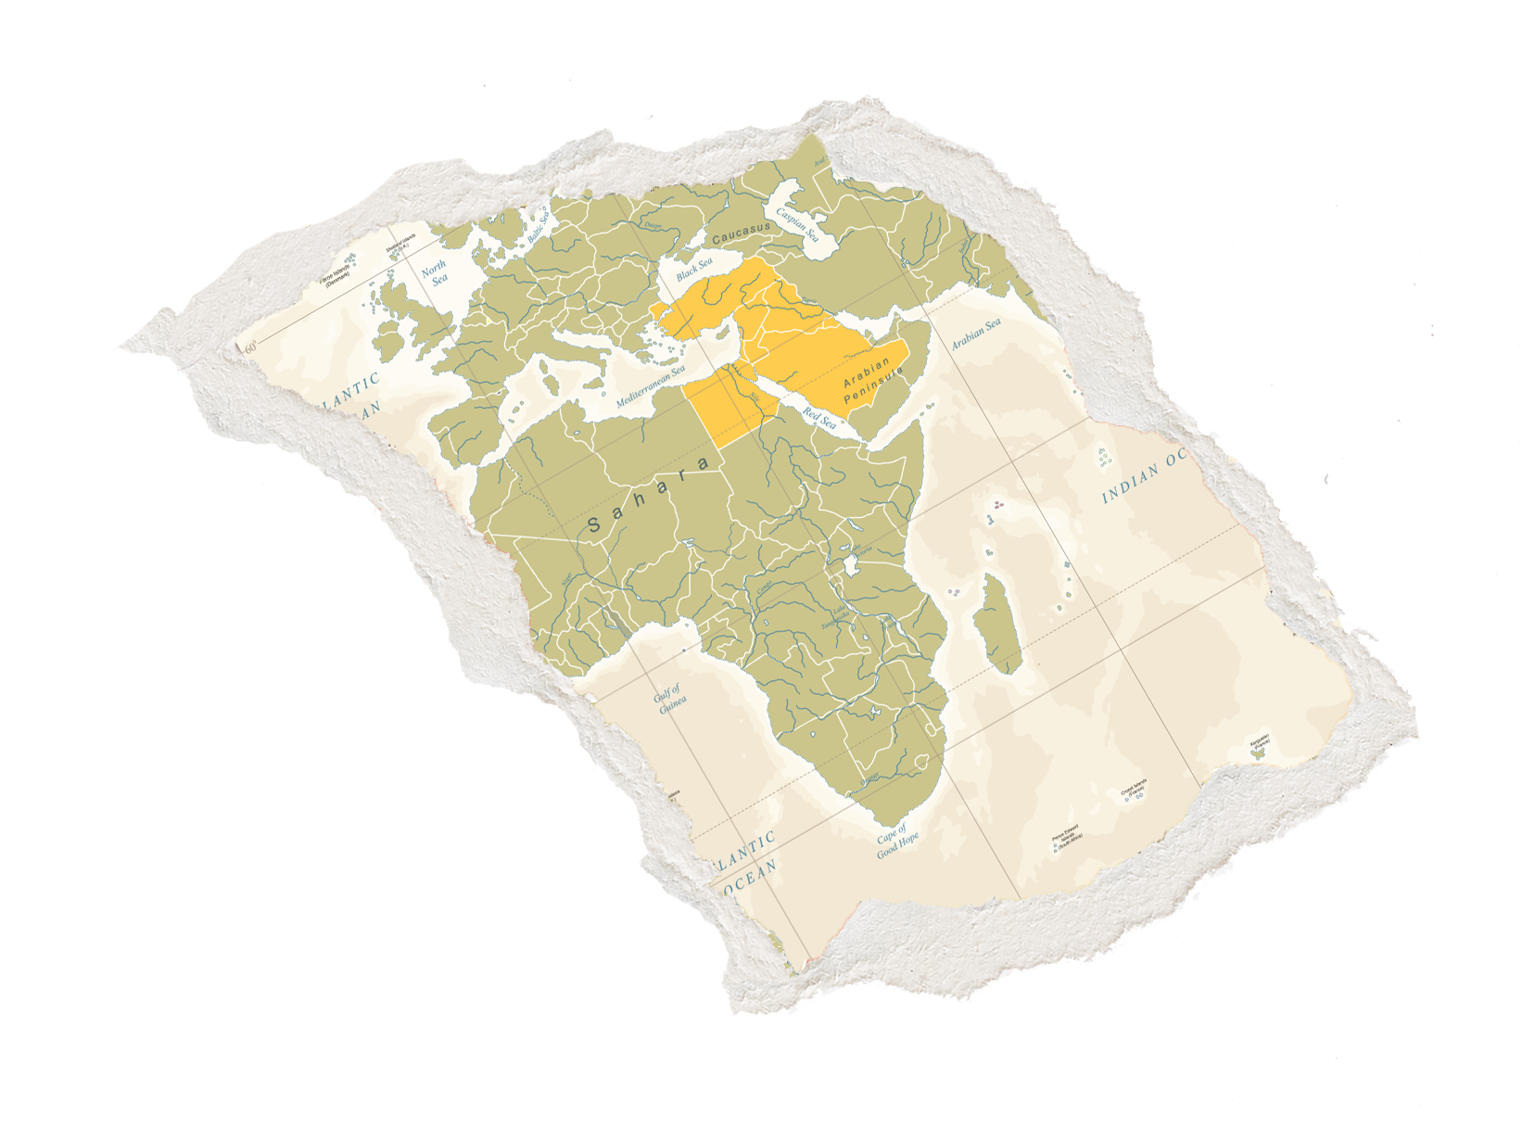
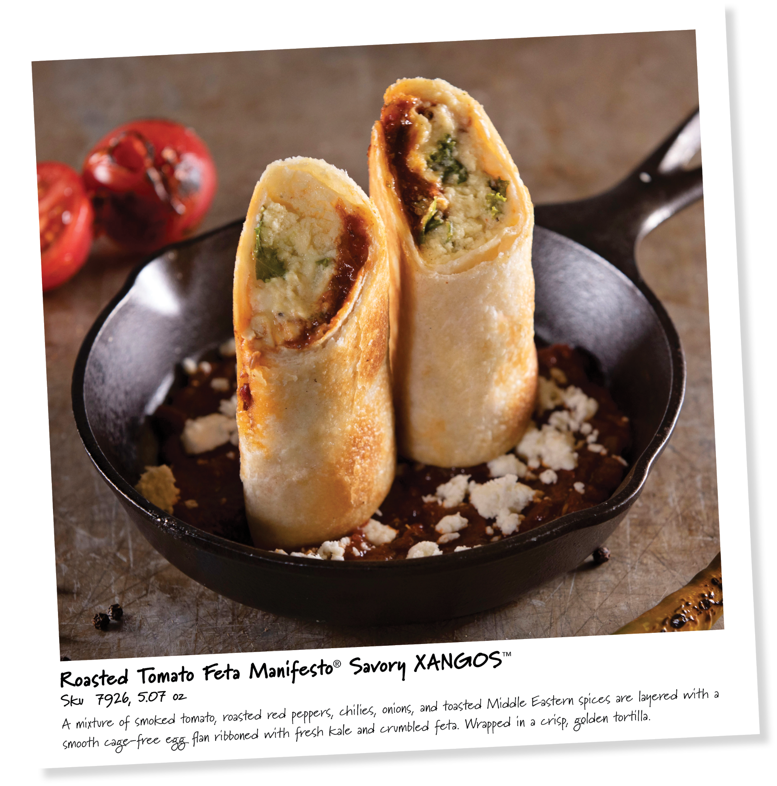
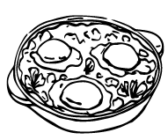
Inspiration: Shakshuka
Tradition:
Ingredients slowly cook on an open fire throughout the morning. As loved ones gather for brunch, the cast iron skillet is placed amidst a courtyard dining table for shared comfort and nourishment.

Slide 16
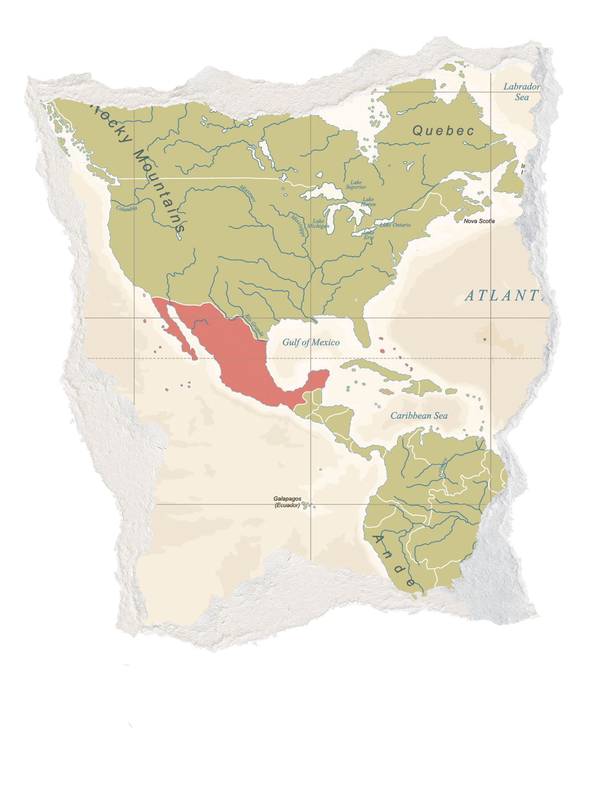
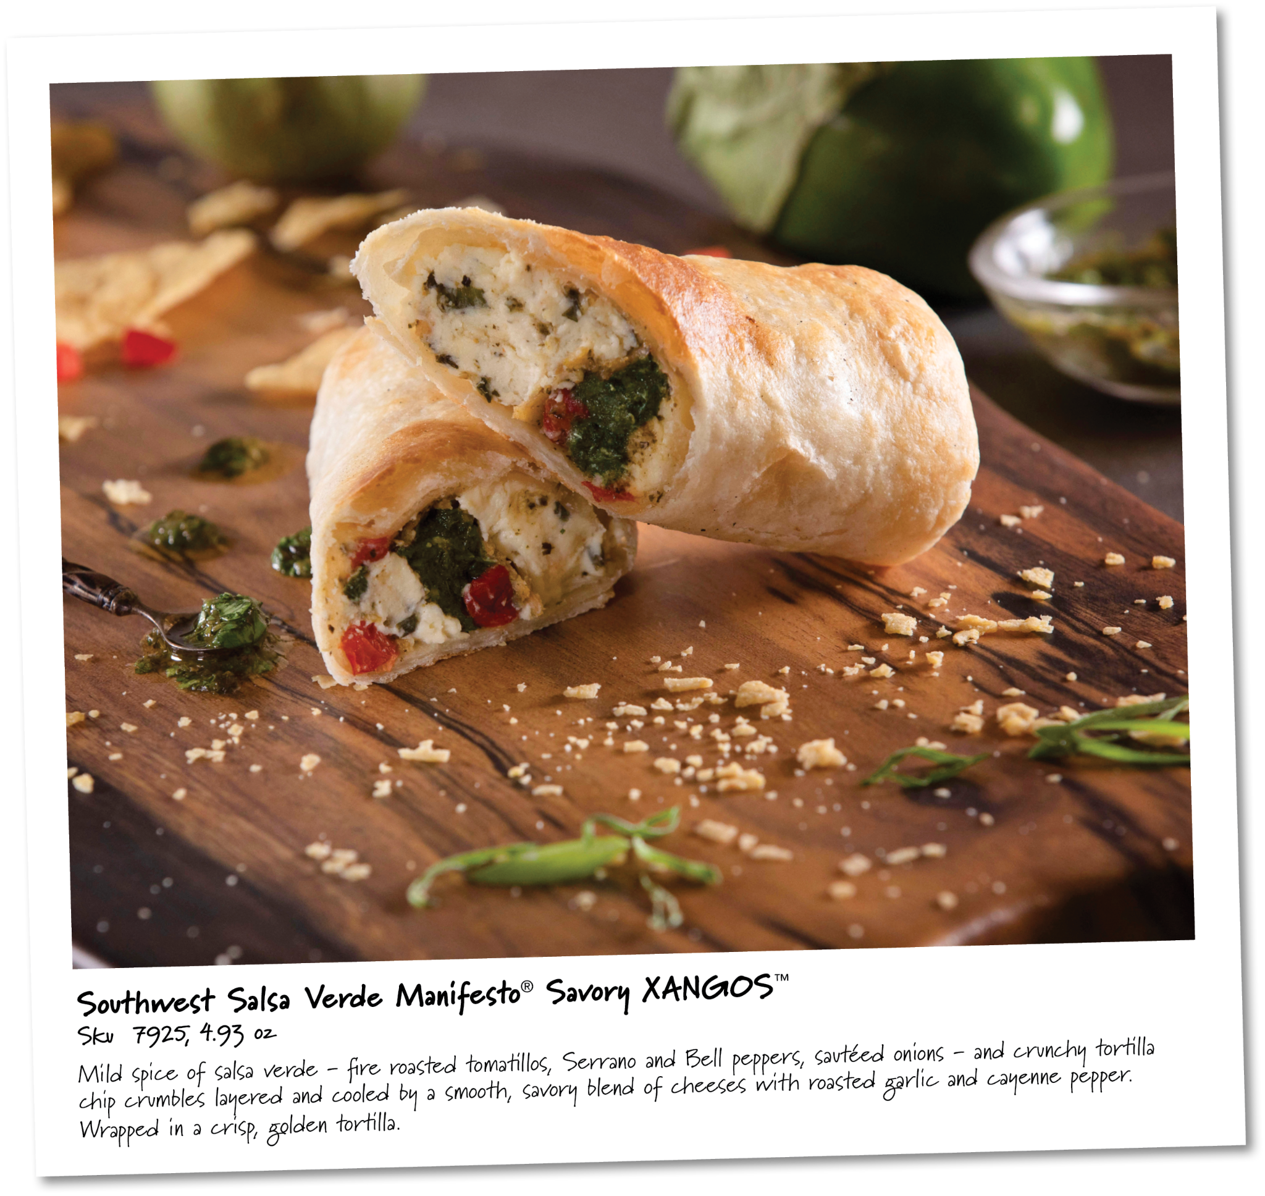
Inspiration: Chilaquiles
Tradition:
For hundreds of years Mesoamerican families have sun-dried leftover tortillas and used them for breakfast the next day - providing a way to stretch resources while making a satisfying meal. In this dish, the crunchy tortillas are simmered in a sauce to soften and topped with favorites.

Slide 17
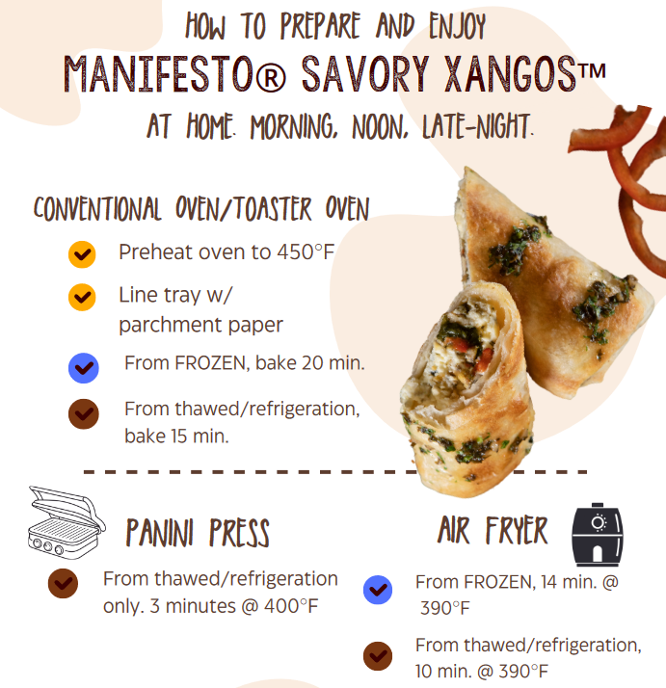
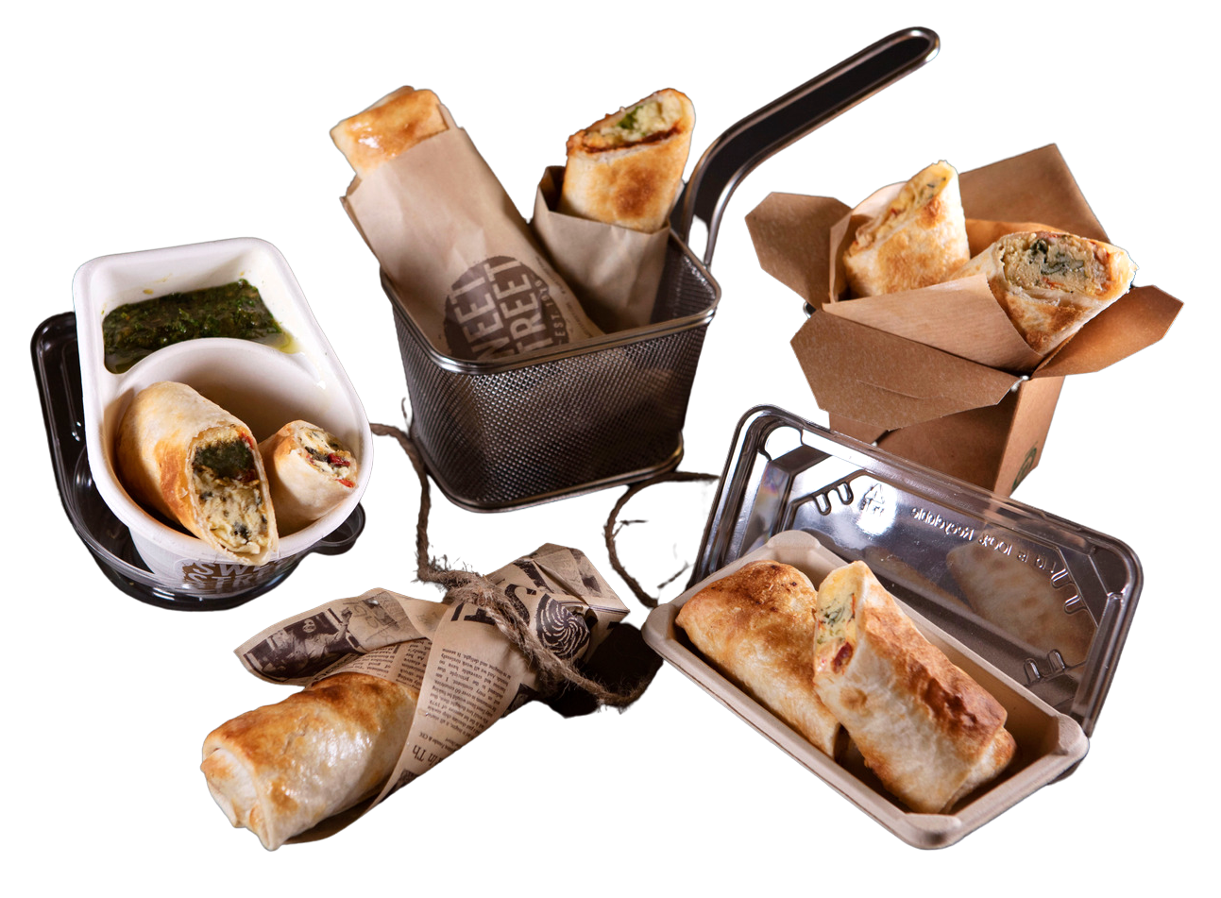
Versatility- all day parts
Grab-and-go
Breakfast
Brunch
Lunch
Dinner
Late Night

Slide 18
Turbo Chef Settings
INSTRUCTIONS All Flavors
Remove wrapper prior to baking. Guidelines for heating 1 XANGO at a time.
Thawing Instructions: Remove the desired amount of portions from the freezer and place on a sheet pan in the cooler, keep in film to prevent drying & defrost overnight. Can be kept refrigerated for up to 7 days prior to heating. Remove film wrapper prior to baking.
500°F/High Fan | Events | % of Time | % Top | % Bottom | % Wave | Time
from FROZEN | 1 | 100 | 60 | 30 | 20 | 2:45
from thawed/Refrigeration | 1 | 100 | 70 | 30 | 20 | 2:10

Slide 19
Merrychef
INSTRUCTIONS All Flavors
1X PORTION FROZEN
Time: 2 minutes & 15-30 seconds
Fan: 10%
Micro: STEP 1: 40% 1 minute 15-20 seconds
STEP 2: 25% 1 minute 15-25 seconds
2X PORTIONS FROZEN
Time: 3 minutes & 15-30 seconds
Fan: 10%
Micro: STEP 1: 40% 1 minute 40-45 seconds
STEP 2: 25% 1 minute 35-45 seconds
1X PORTION THAWED/REFRIGERATED
Time: 1 minute & 30 seconds
Fan: 60%
Micro: 30%
2X PORTIONS THAWED/REFRIGERATED
Time: 2 minutes & 15 seconds
Fan: 45 %
Micro: 35 %

Slide 20
Thank you!
For heating instructions, ingredients & nutritionals for our Manifesto® Savory XANGOS™ visit sweetstreet.com or scan or click here.

